Slide 1

High-order Proximity Preserving Information Network Hashing

Slide 2
Existing methods：
computational challenges in problems such as link prediction and node recommendation
MF-based Information Network Hashing (INH-MF):
dramatically accelerating knn(k-nearest neighbor)-dependent network analytics
address the sparsity challenge and preserve high-order proximity
an efficient parameter learning algorithm based on alternating optimization

Slide 3




DEFINITION
an information network
represent each node v ∈ V into a low-dimensional Hamming space {±1}^{d}
the proximity between node i and j
the loss function for information network hashing
bit balance and uncorrelation conditions

Slide 4

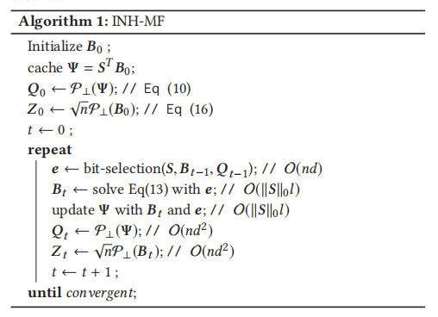





INH-MF
assume P and Q corresponds to the role of node itself and “context” of other nodes

Slide 5


Hamming Subspace Learning
to scaling up information network hashing algorithms
to update partial binary codes each time
l is the number of selected bits
first score the i-th bit by q_{i}S^{T}b_{i} , and select l bits with smallest scores

Slide 6
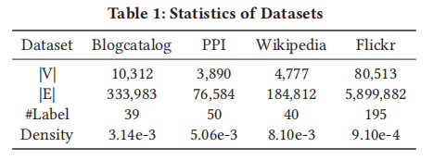
EXPERIMENTS
Baselines：
LINE Spectral Hashing (SH)
DeepWalk Hashing with Graphs (AGH-1, AGH-2)
NetMF Inductive Hashing on Manifold with LE manifold learning (IMH-LE)
Iterative Quantization (ITQ)
Discrete Collaborative Filtering (DCF)

Slide 7
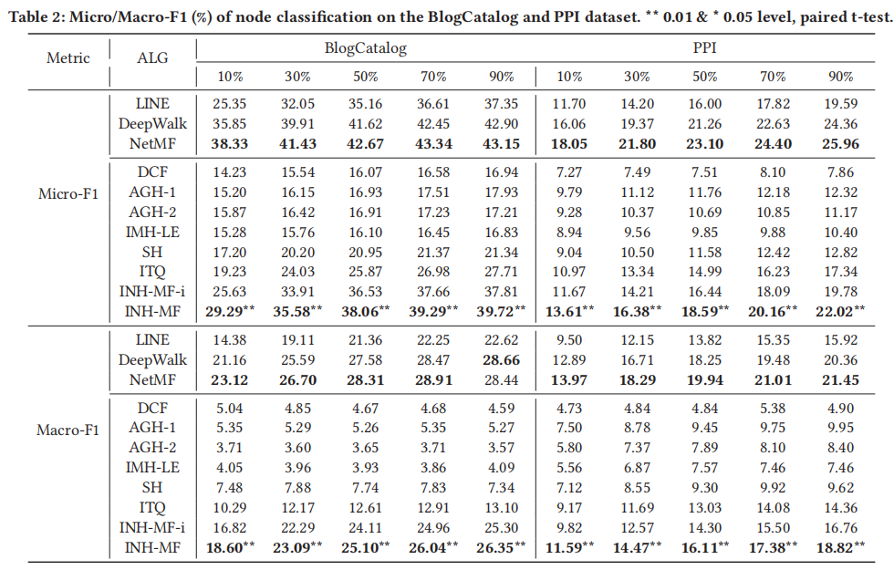

Slide 8
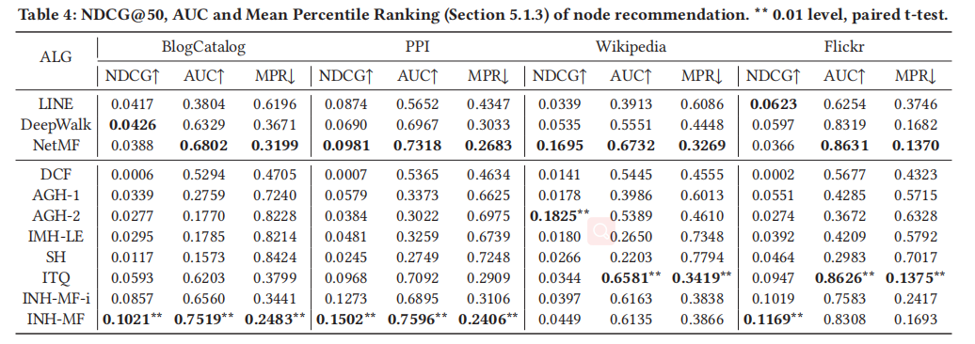

Slide 9
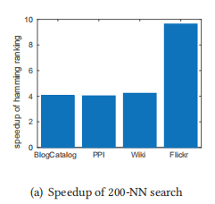
networks with a larger size will gain more speedup

